Slide 1
WSO2 API Manager 4.2.0 Developer Advanced
Tuning and Performance
WSO2 Training

Slide 2
Tuning and Performance
OS-level settings
JVM-level settings
WSO2 Carbon platform-level settings
APIM-level settings

Slide 3
OS-Level Settings

Slide 4
OS-Level (Linux Based) Settings
When it comes to performance, the OS that the server runs, plays an important role.
To optimize network and OS performance, configure the following settings in the /etc/sysctl.conf file of Linux.
These settings specify a larger port range, a more effective TCP connection timeout value, and a number of other important parameters at the OS-level.
net.ipv4.tcp_fin_timeout = 30
fs.file-max = 2097152
net.ipv4.tcp_tw_recycle = 1
net.ipv4.tcp_tw_reuse = 1
net.core.rmem_default = 524288
net.core.wmem_default = 524288
net.core.rmem_max = 67108864
net.core.wmem_max = 67108864
net.ipv4.tcp_rmem = 4096 87380 16777216
net.ipv4.tcp_wmem = 4096 65536 16777216
net.ipv4.ip_local_port_range = 1024 65535

Slide 5
OS-Level (Linux Based) Settings…
To alter the number of allowed open files for system users, configure the following settings in the /etc/security/limits.conf file of Linux (be sure to include the leading * character).
* soft nofile 4096
* hard nofile 65535
Optimal values for these parameters depend on the environment.
To alter the maximum number of processes your user is allowed to run at a given time, configure the following settings in the /etc/security/limits.conf file of Linux.
Each carbon server instance you run would require upto 1024 threads (with default thread pool configuration). Therefore, you need to increase the nproc value by 1024 per each carbon server (both hard and soft).
* soft nproc 20000
* hard nproc 20000
OS-Level Settings

Slide 6
JVM-Level Settings

Slide 7
JVM-Level Settings
When an XML element has a large number of sub elements and the system tries to process all the sub elements, the system can become unstable due to a memory overhead. This is a security risk.
To avoid this issue, you can define a maximum level of entity substitutions that the XML parser allows in the system.
You do this using the entity expansion limit as follows in the <API-M_HOME>/bin/wso2server.bat file (for Windows) or the <API-M_HOME>/bin/wso2server.sh file (for Linux/Solaris).
(The default entity expansion limit is 64000).
-DentityExpansionLimit=10000
In a clustered environment, the entity expansion limit has no dependency on the number of worker nodes.
JVM-Level Settings

Slide 8
Platform-Level Settings

Slide 9
WSO2 Carbon Platform-Level Settings
In multi-tenant mode, the WSO2 Carbon runtime limits the thread execution time.
If a thread is stuck or taking a long time to process, Carbon detects such threads, interrupts and stops them.
Carbon prints the current stack trace before interrupting the thread.
This mechanism is implemented as an Apache Tomcat valve.
Therefore, it should be configured in the <PRODUCT_HOME>/repository/conf/tomcat/catalina-server.xml file as shown below.
<Valve className="org.wso2.carbon.tomcat.ext.valves.CarbonStuckThreadDetectionValve" threshold="600"/>
The className is the Java class used for the implementation. Set it to
org.wso2.carbon.tomcat.ext.valves.CarbonStuckThreadDetectionValve .
The threshold gives the minimum duration in seconds after which a thread is considered stuck. The default value is 600 seconds.
Carbon Platform-Level Settings

Slide 10
APIM-Level Settings

Slide 11
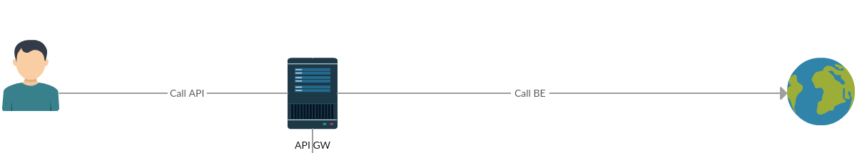
API-M Level Settings
The following diagram shows the communication/network paths that occur when an API is called.
JWT access tokens are the default token type for applications. As JWTs are self-contained access tokens, the Key Manager is not needed to validate the token, and the token is validated from the Gateway.

Slide 12
Timeout Configurations for an API Call
Client call API Gateway + API Gateway call Backend : for backend communication, the API Manager uses PassThrough transport.
This is configured in the <API-M_HOME>/repository/conf/deployment.toml file.
To configure socket timeout value, add the following to the deployment.toml [passthru_http]
http.socket.timeout=180000
Timeout Configurations for an API Call

Slide 13
General API Manager Level Recommendations
Some general API-M-level recommendations related to performance are listed in the below page
General APIM-Level Recommendations

Slide 14
Registry Indexing Configurations
The registry indexing process is only required to be run on the API Publisher and Developer Portal nodes.
To disable the indexing process from running on the other nodes (Gateways and Key Managers), you need to disable the following in the <API-M_HOME>/repository/conf/deployment.toml file.
[indexing]
enable = false
Registry Indexing Configurations

